Slide 1
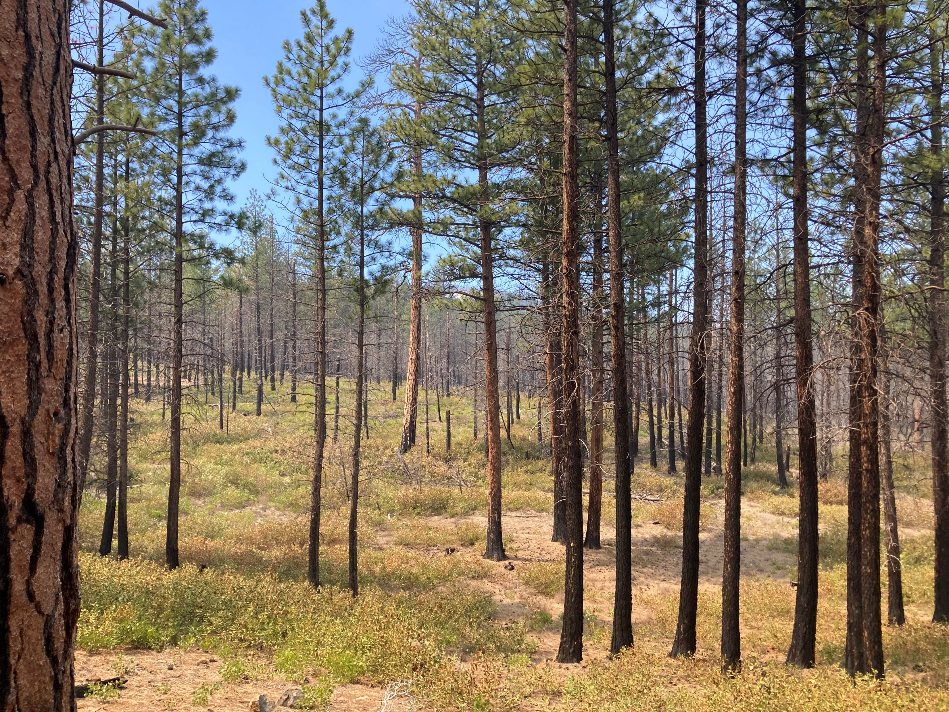
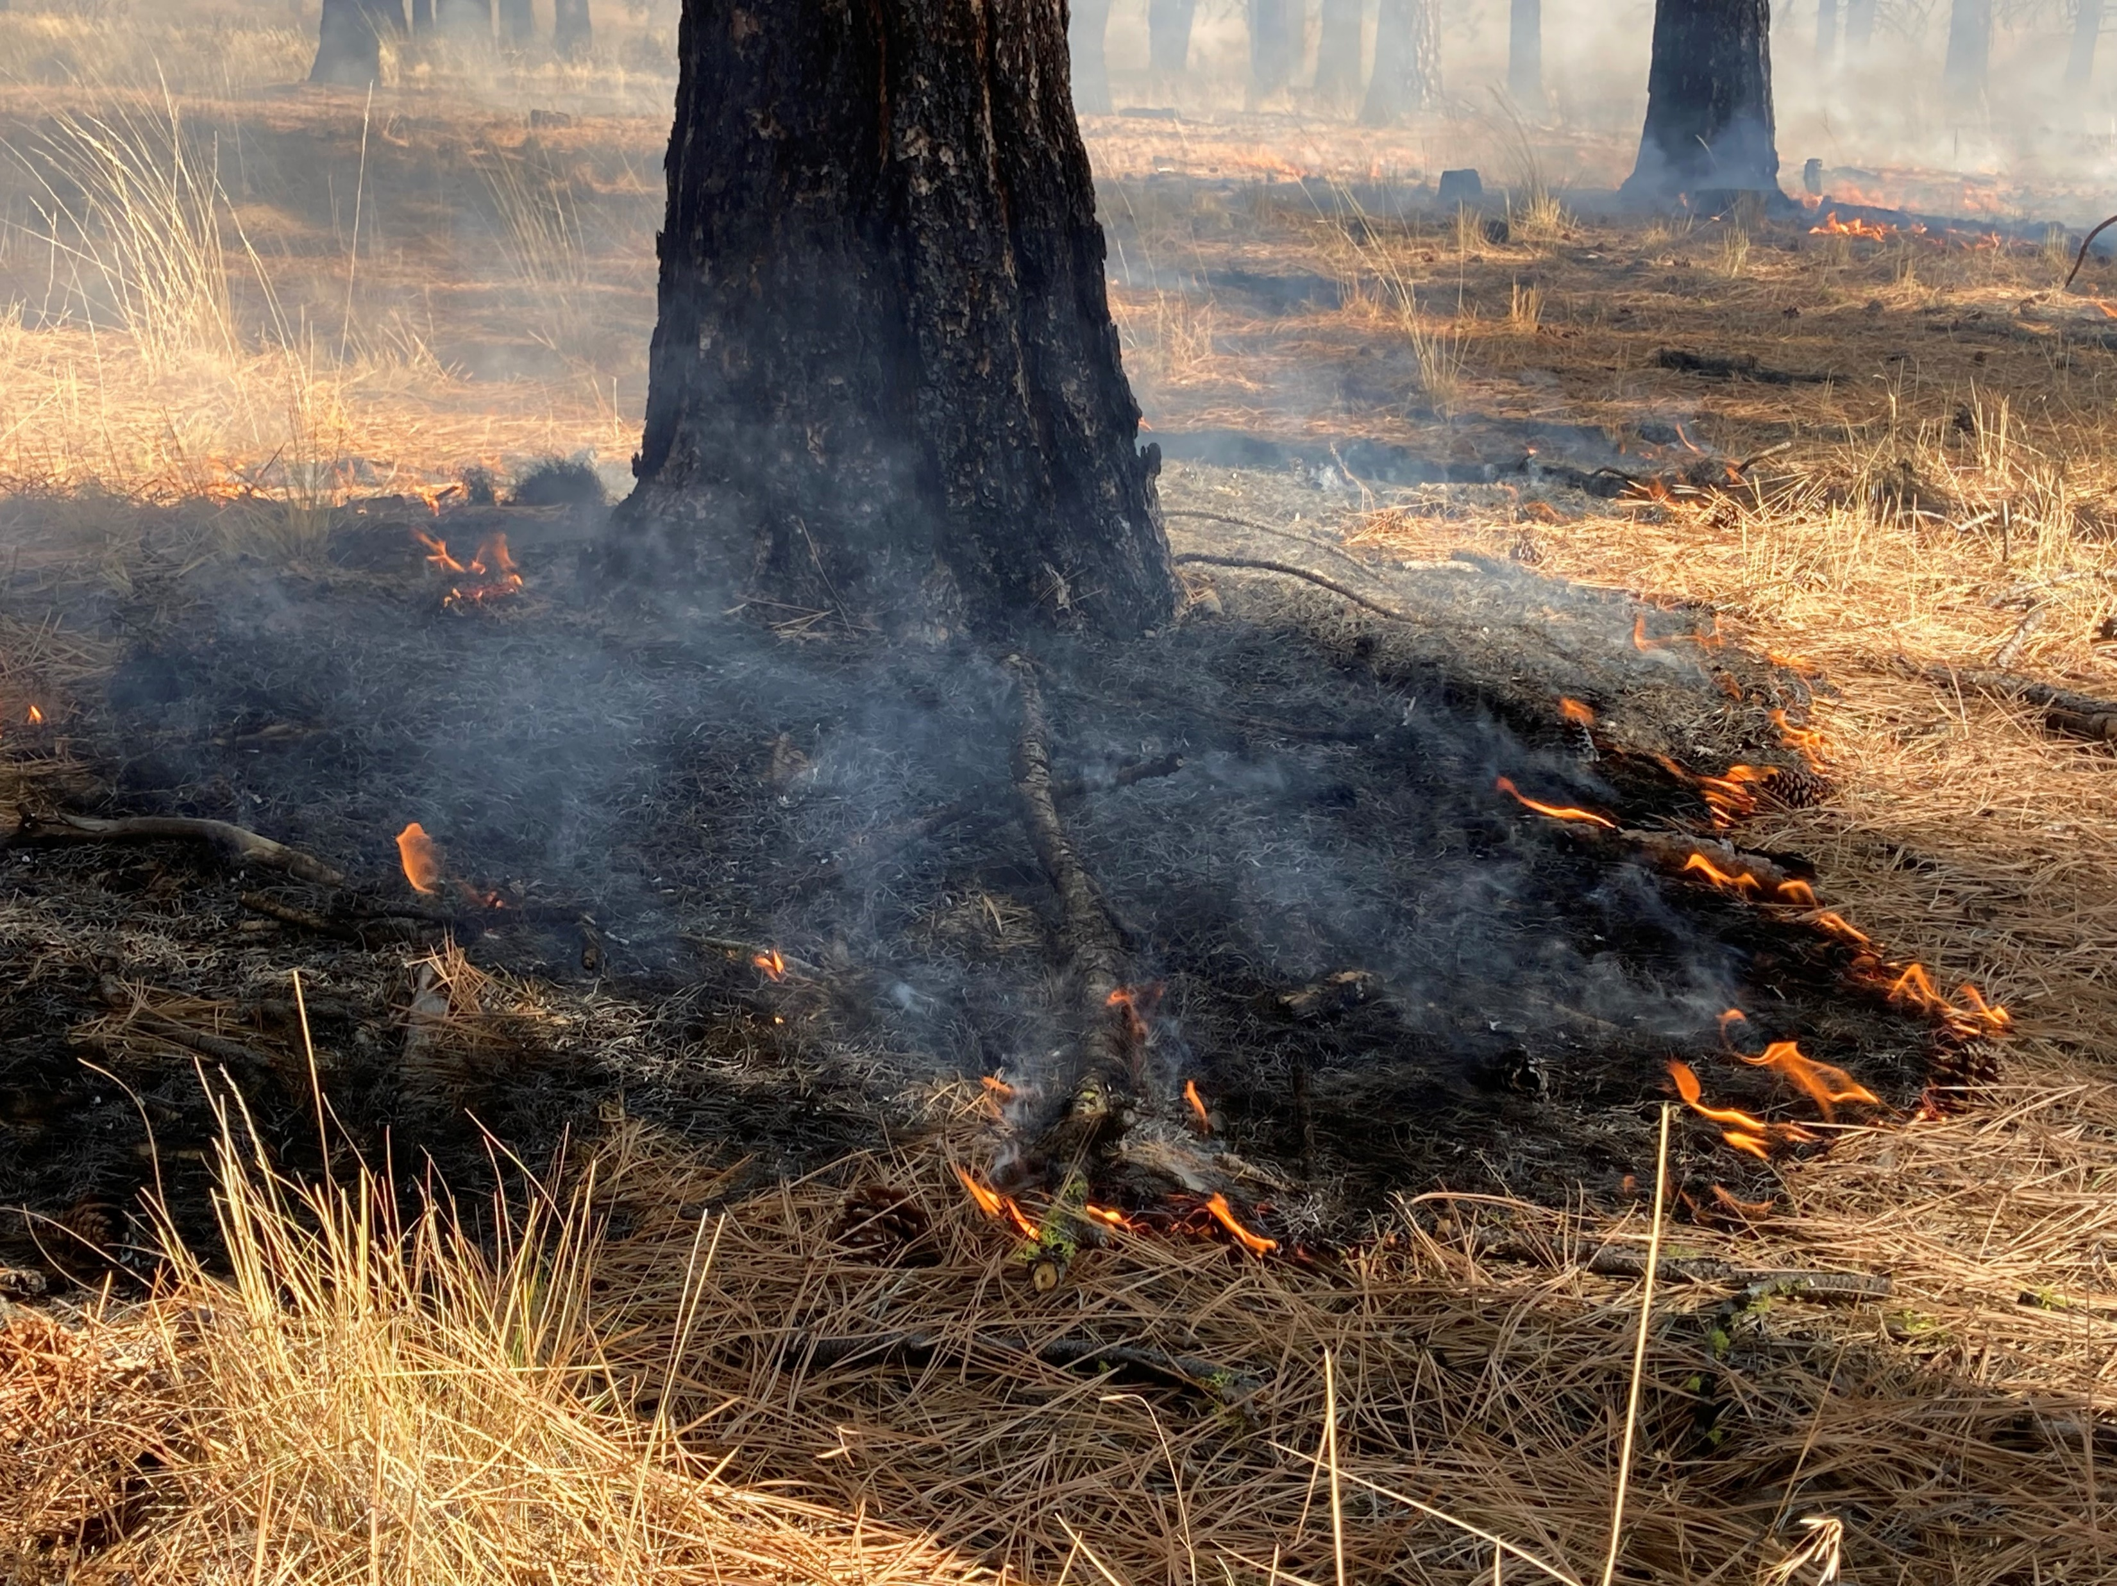
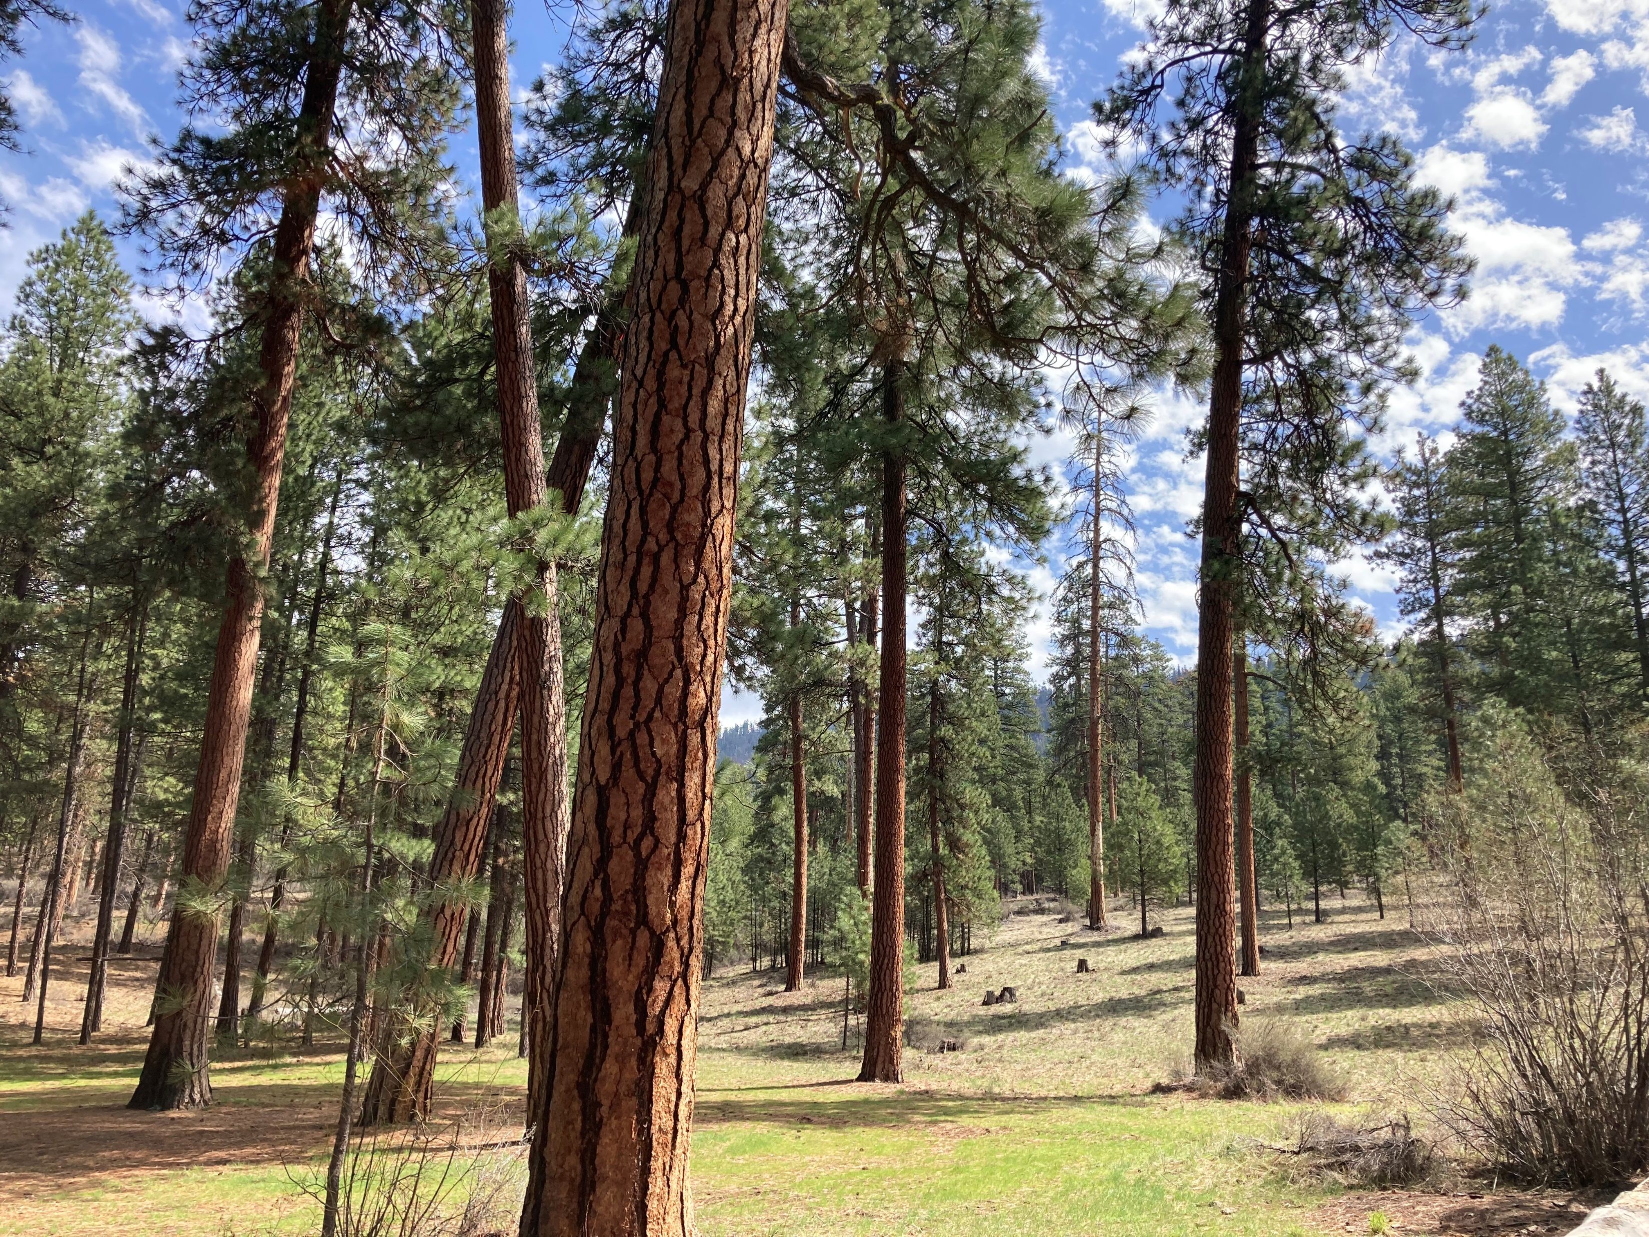

Building a prescribed fire database for the western United States
Kori Blankenship & Teresa Chapman
The Nature Conservancy
kblankenship@tnc.org - tchapman@tnc.org
Association for Fire Ecology Congress, December 2023

Slide 2
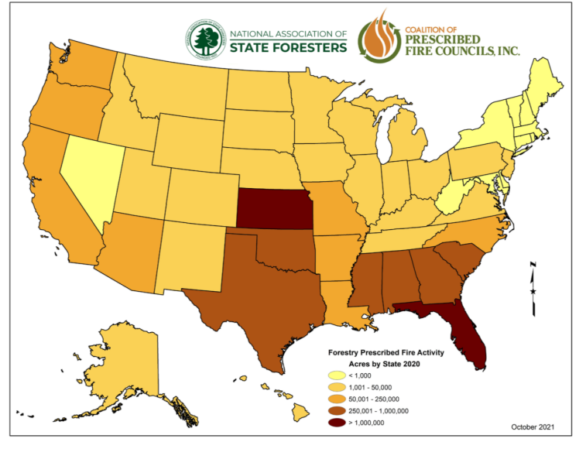
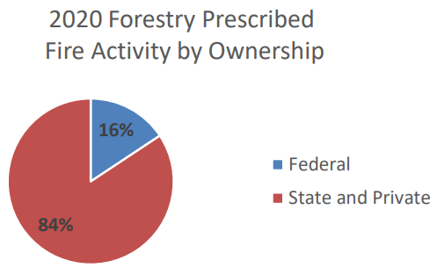
Background
Limited information on when and where prescribed fires occur on private land.
Prescribed fire use on all ownerships, 2020
Figures: 2021 National Prescribed Fire Use Survey Report, Coalition of Prescribed Fire Councils and the National Association of State Foresters
Notes:
Interested in fuel tx effectiveness when encountered by wildfire > need info on treatments
No reporting system for all burns; no known public repository for burning on private lands
Interested in an all lands approach b/c:
Data suggests that US-wide most prescribed burning is happening on state and private land
Private lands transmit a lot of wildfire to national forests (Downing et al. 2022)
Report info: 2021-National-Rx-Fire-Use-Report_FINAL.pdf (prescribedfire.net)
-1.5 m acres fed burning; 7.9 acres state and private
-This report uses the best information available from state forestry agencies; -based on a survey of prescribed fire use data collected in 2020
-The collected survey data covered all 2020 federal, state, and private prescribed burning activity that occurred specifically on forestlands and rangelands.
-Map from figure 2 in the report
Downing et al: s41598-022-06002-3.pdf

Slide 3
Objective
Create an all-lands prescribed fire records database for 11 western states
State | Information tracked |  |  |  | Years of data
 | Permitted acres | Requested acres | Completed acres | Burn type | pre-2010 | 2010 | 2011 | 2012 | 2013 | 2014 | 2015 | 2016 | 2017 | 2018 | 2019 | 2020 | 2021 | 2022
AZ
CA
CO
ID
MT
NM
NV
OR
UT
WA
WY
Notes:
Public records requests for state permits to get more complete picture
State permit data are, to our knowledge, an untapped resource for tracking prescribed burns. These data will be especially useful for tracking burning on private lands, which are largely left out of other data collection efforts.
prescribed fire records database - PFRD
~275k points
ND IS WRONG HERE
Make a horizontal bar plot w/ # of records and give the n as shown in screen cap above
Map: burn type reported, ag burns, Indian lands burns, permitted, complete, request

Slide 4
Methods
Database attributes
Date
Latitude
Longitude
Acres permitted
Acres requested
Acres completed
Pile volume
Burn name
Burn type
Entity requesting
Cleaning
Standardizing
Calculating variables:
Unique burns: state, year, location, burn type, number, name
Planned acres: permitted acres if available, else max requested
Notes:
1. cleaning: fixed lat/lons, removed duplicate records
2. Standardizing – classified as burn/pile, limited to overlapping years, removed ag, barrel burning
3. Unique burns

Slide 5
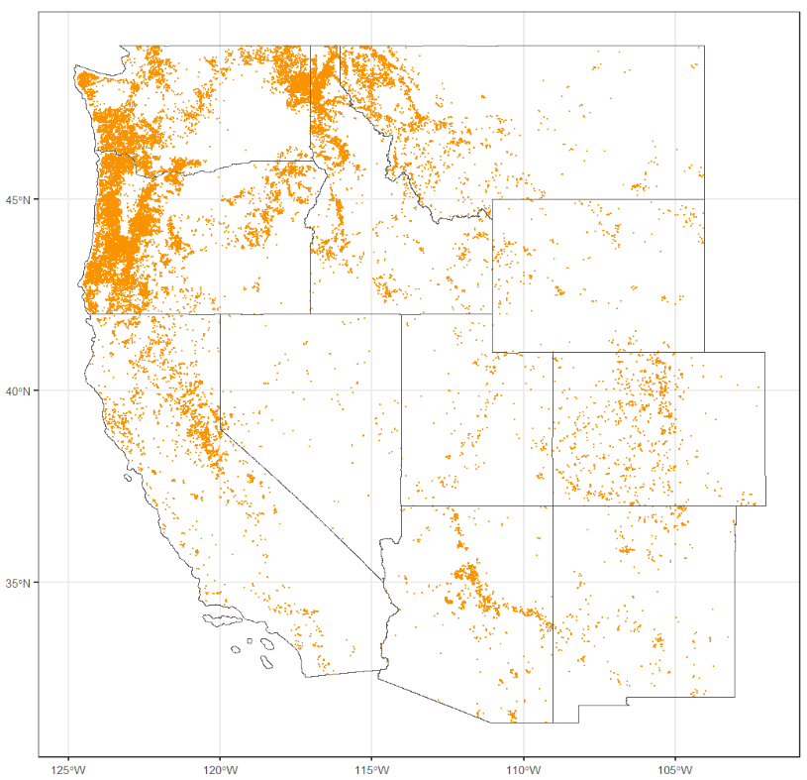
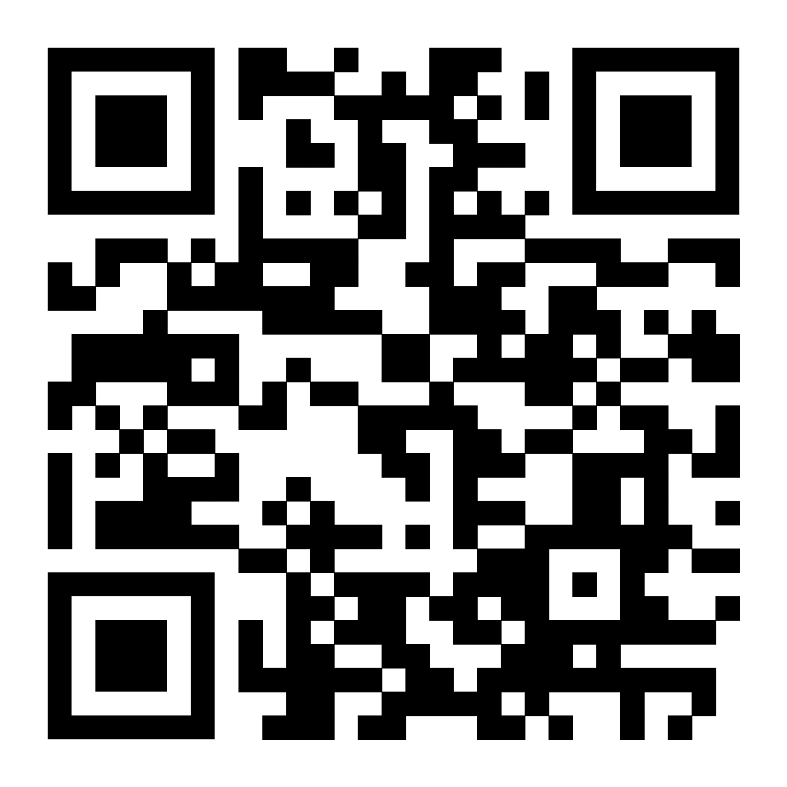
Results
Westwide -
6,065 Broadcast
49,992 Piles
575 Unknown
56,632 Total
Planned and completed burns 2017-2022
Draft interactive map:
koriblankenship.github.io/StateRx/map.html
Notes:
56,610 burns

Slide 6
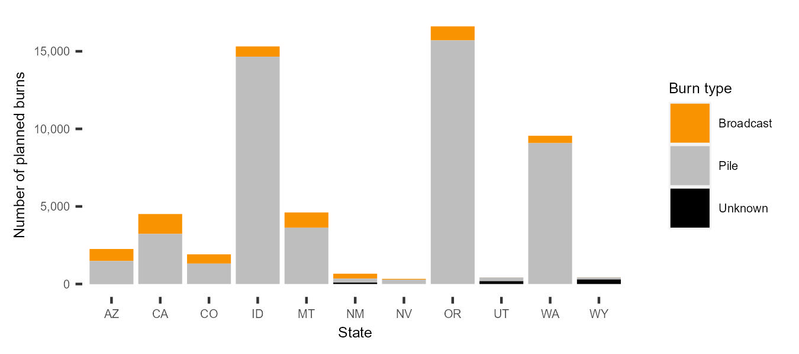
Results
Westwide - 8 times more pile than broadcast burns are reported.
Number of reported burns 2017-2022 (11 states)

Slide 7
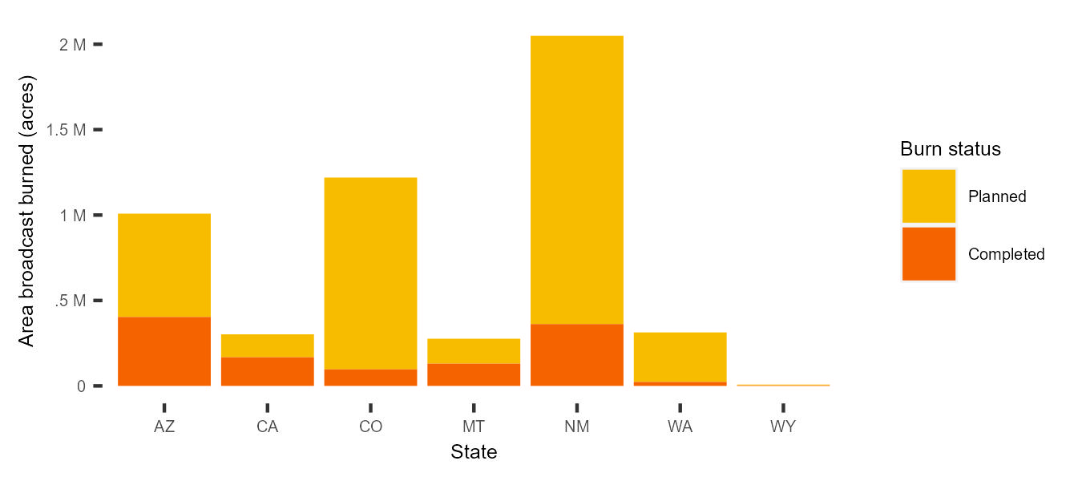
Results
Westwide – 23% of planned broadcast burns are completed.
Area of broadcast burns 2017-2022 (7 states)
Notes:
ACRES ON THE GRAPH (AT TOP OF EACH STATE GIVE A PERCENT); ADD AS TEXT THE % COMPLETE FOR EACH STATE
Map icon in bottom showing states included
Total of 1,345,896 acres westwide over 7 years; ~192,271 per year
Planned acres calculated as: permitted acres if available, otherwise max requested acres

Slide 8
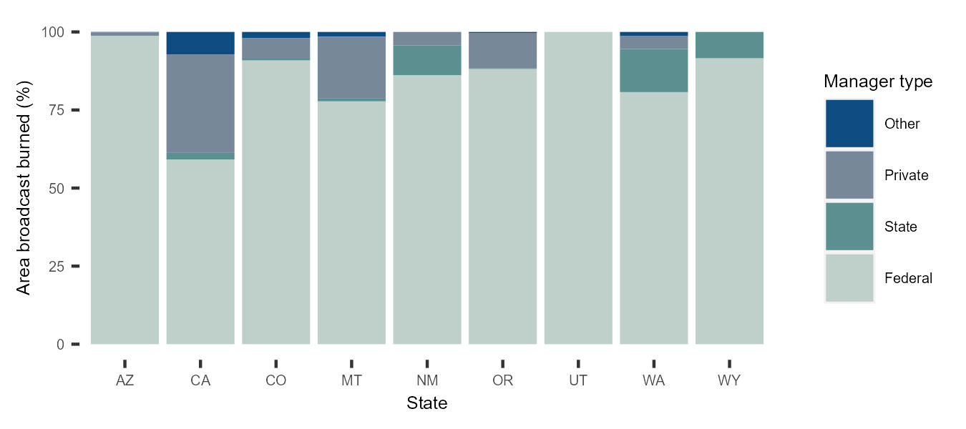
Results
Westwide - 86% of the area broadcast burned is on federal lands.
Percent area broadcast burned by land manager 2017-2022 (9 states)
Notes:
~9% is private, the 2nd largest land ownership
NOTES
this is for completed broadcast burns

Slide 9
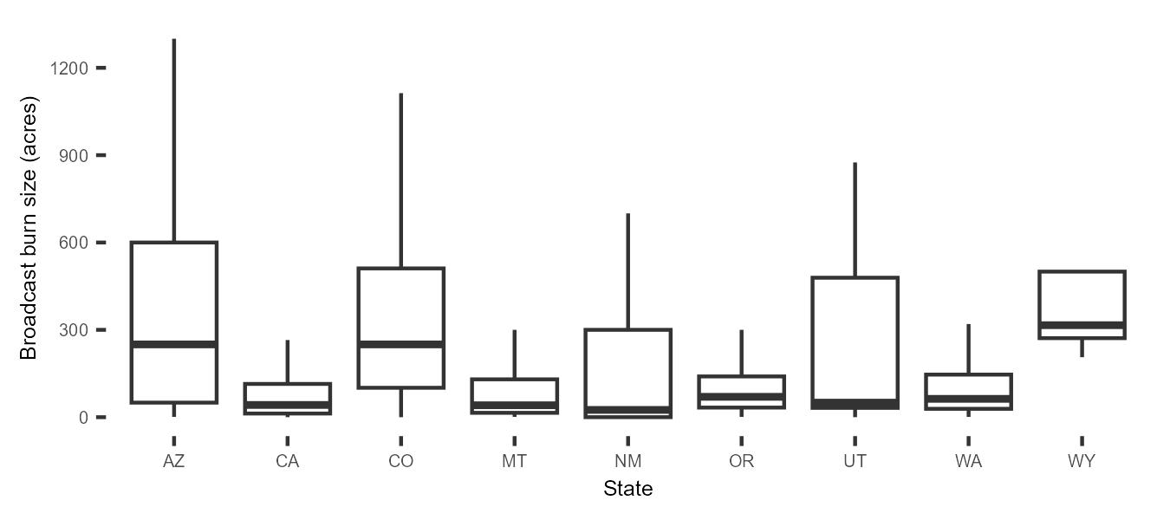
Results
Westwide - median completed broadcast burn size is 70 acres (mean = 331 acres).
Size of completed broadcast burns 2017-2022 (9 states)
Notes:
Westwide mean completed broadcast fire size = 300 acres

Slide 10
Summary
More pile than broadcast burn records.
More broadcast burns are planned than completed.
Majority of broadcast burns occur on federal lands in the West.
Broadcast burns are relatively small in size.
Notes:
Time specific and for the west

Slide 11
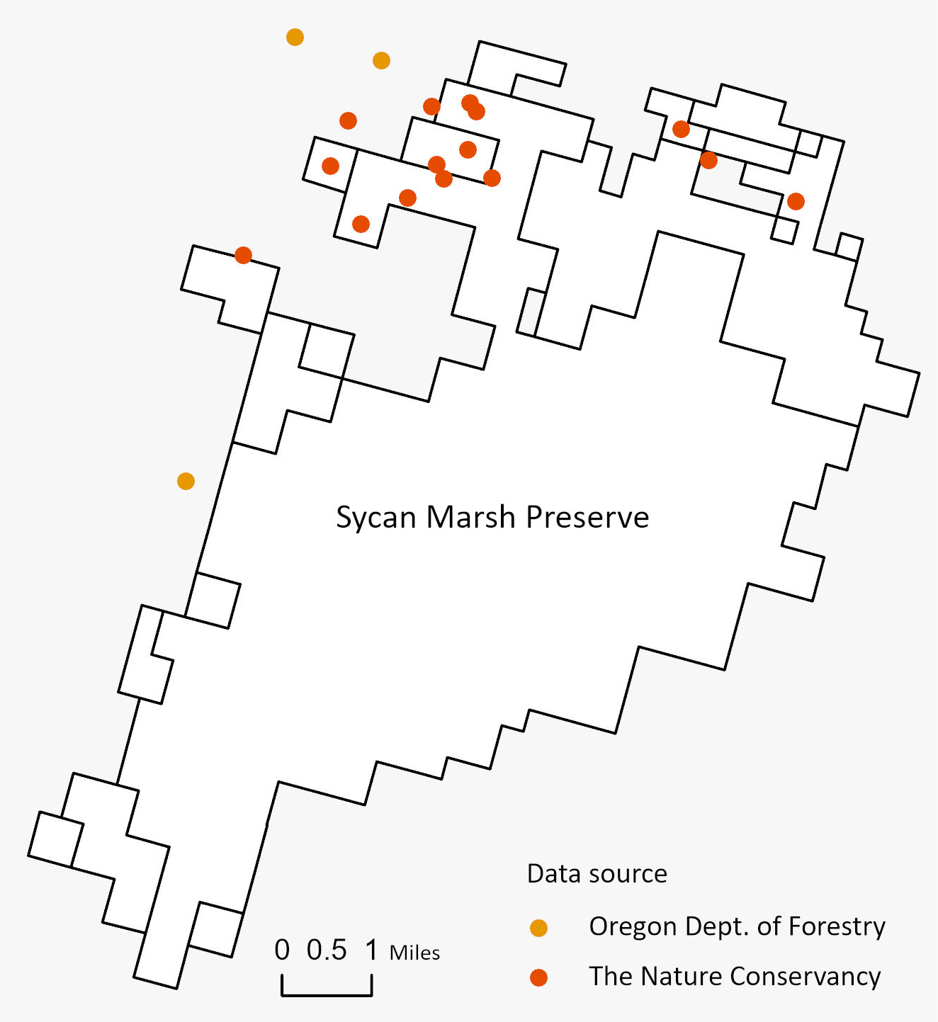
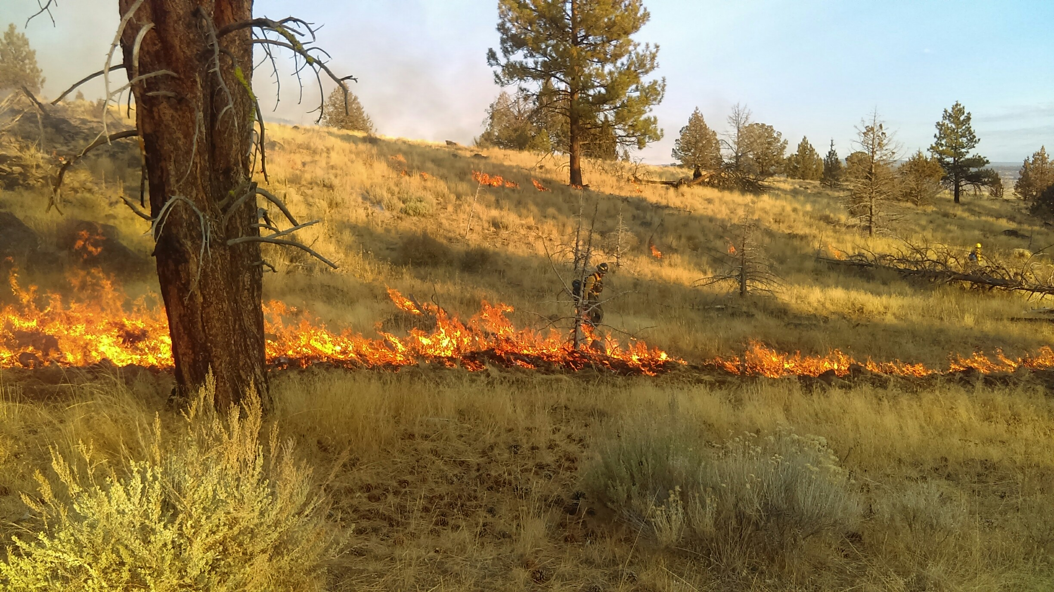
Next steps
Example of public records missing data on private land
Prescribed fire on The Nature Conservancy’s Sycan Marsh Preserve, OR.
Notes:
Build complete TNC rx database to estimate completeness of private land data
Validation: imagery, other data sources (NFPORS, FACTS, SIT 209, Inform)
[Database: quantifying pile burning in a standard way]

Slide 12
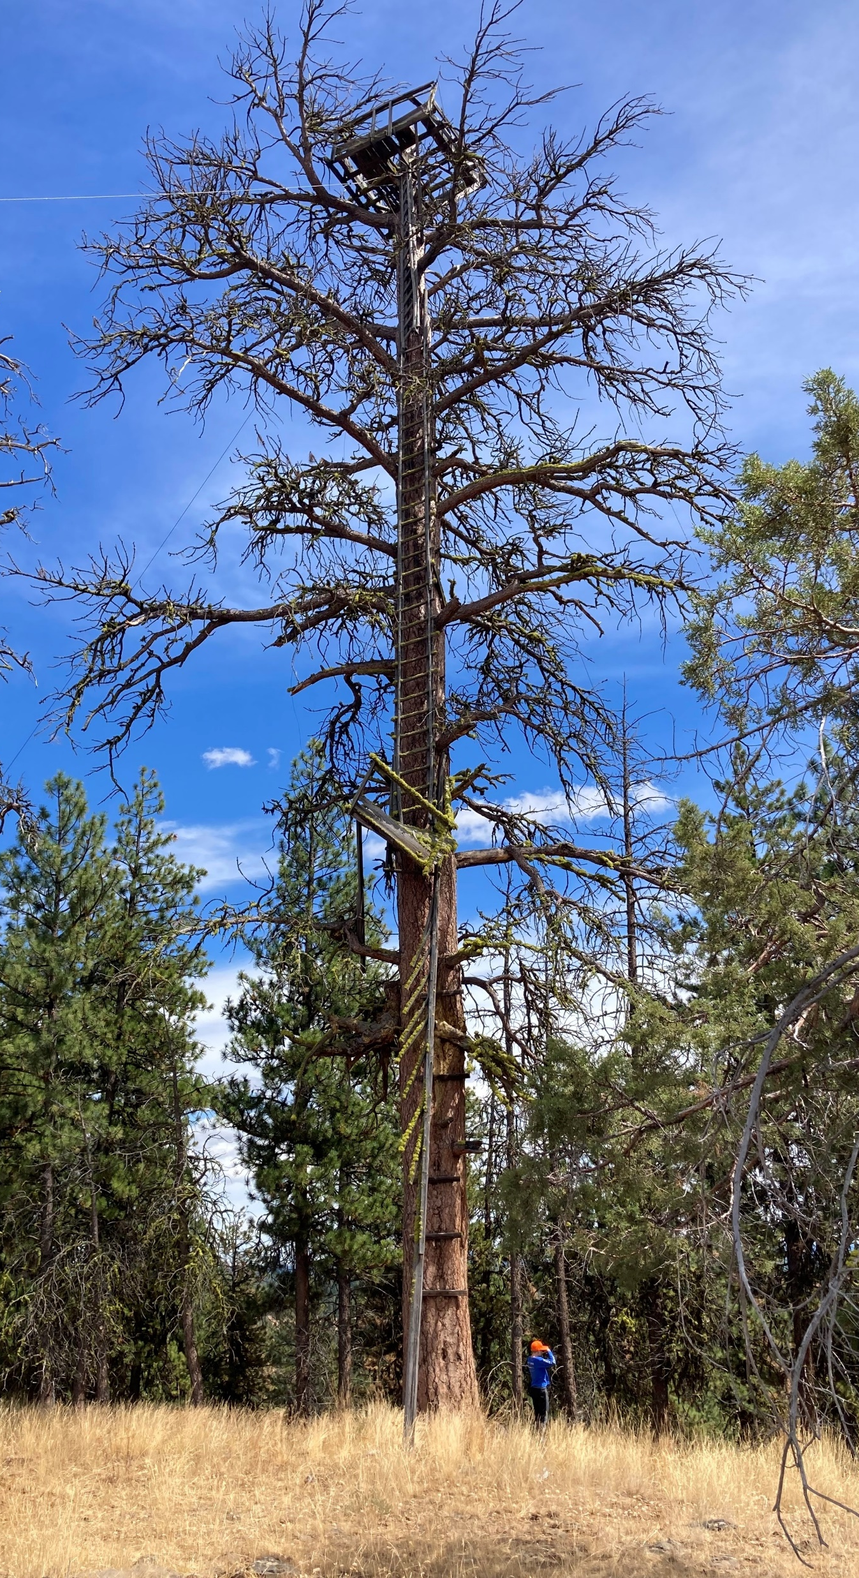
Opportunities
Leverage existing federal records systems to better understand completeness of Prescribed Fire Records Database.
Integrate Prescribed Fire Records Database with remotely sensed products to validate burn completeness and understand remote detection of prescribed fire.
Black Mountain Lookout tree, OR.
Notes:
Understanding of prescribed burning is limited due to lack of data consistency and completeness.
Validate public records with the federal records
Use products (e.g. usgs burned area, fired) to
validate if burns in the public record occurred
Improve our understanding of what burns can be remotely sensed
Original wording of bullets:
Leverage current efforts to create comprehensive prescribed fire databases on federal lands to better understand completeness of public records.
Integrate public record data with remotely sensed products to validate burn completeness and understand detection of prescribed fire.

